Slide 1

Data Analyst Capstone Project
Naznin Sharmin Shishir
October 12, 2026

Slide 2



OUTLINE
Executive Summary
Introduction
Methodology
Results
  Visualization – Charts
  Dashboard
Discussion
  Findings & Implications
Conclusion
Appendix

Slide 3

EXECUTIVE SUMMARY
PROJECT AT A GLANCE
• Explored Stack Overflow developer-survey fields using Python, Pandas, SQL/SQLite and Matplotlib.
• Focused on compensation, age, work arrangement, experience, job satisfaction and technology preferences.
• Used distributions, box plots, scatter/bubble plots, stacked bars and line charts to compare variables.
• Official 2025 survey context highlights:
– 84% use or plan to use AI tools in development.
– 46% distrust AI output accuracy, compared with 33% who trust it.
– Python adoption increased by 7 percentage points year over year.
• Practical takeaway: technology adoption, job experience and satisfaction should be analyzed together—not in isolation.

Slide 4

INTRODUCTION
PURPOSE, AUDIENCE & VALUE
• Purpose: turn developer-survey responses into clear evidence about work patterns and technology choices.
• Audience: entry-level data analysts, hiring teams, educators and technology decision-makers.
• Questions explored:
– How do compensation and job satisfaction vary by age and experience?
– Which work arrangements and employment groups are represented?
– Which programming languages, databases and platforms are used or desired?
• Value: demonstrate a repeatable workflow for data cleaning, exploratory analysis and communicating findings.
• Scope note: local project calculations should be refreshed from the original CSV before reporting exact sample-specific statistics.

Slide 5

METHODOLOGY
DATA SOURCES & WORKFLOW
• Primary project dataset: Stack Overflow Developer Survey CSV (loaded as survey-data.csv).
• Analysis environment: Python, Pandas, Matplotlib and SQLite database survey-data.sqlite; survey table: main.
• Data preparation:
– Inspected columns and missing values; converted compensation and satisfaction fields to numeric.
– Split semicolon-separated multi-select responses before counting technologies.
– Grouped by age, employment, country or experience to calculate counts and medians.
• Visual analysis: histograms, box plots, scatter/bubble plots, stacked bars and line charts.
• Published context: official 2025 Stack Overflow survey summary. The CSV was not attached to this request, so figures shown here are cited published aggregates, not recalculated row-level results.

Slide 6

RESULTS & VISUAL ANALYSIS
The following slides summarize the analysis questions and provide verified public survey context where exact local output was unavailable.

Slide 7
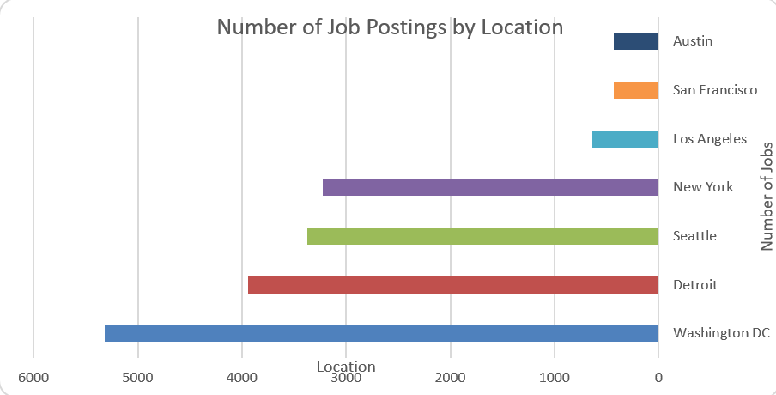
JOB POSTINGS
Source: Stack Overflow Developer Survey 2025 (official published aggregate results) | https://survey.stackoverflow.co/2025/

Slide 8
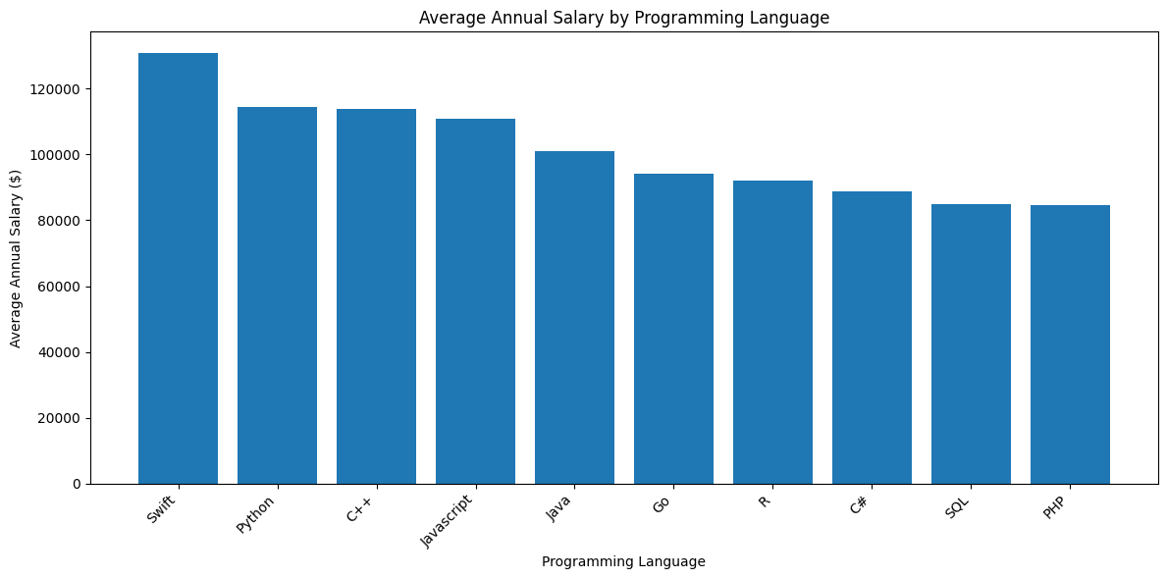
POPULAR LANGUAGES
Source: Stack Overflow Developer Survey 2025 (official published aggregate results) | https://survey.stackoverflow.co/2025/

Slide 9
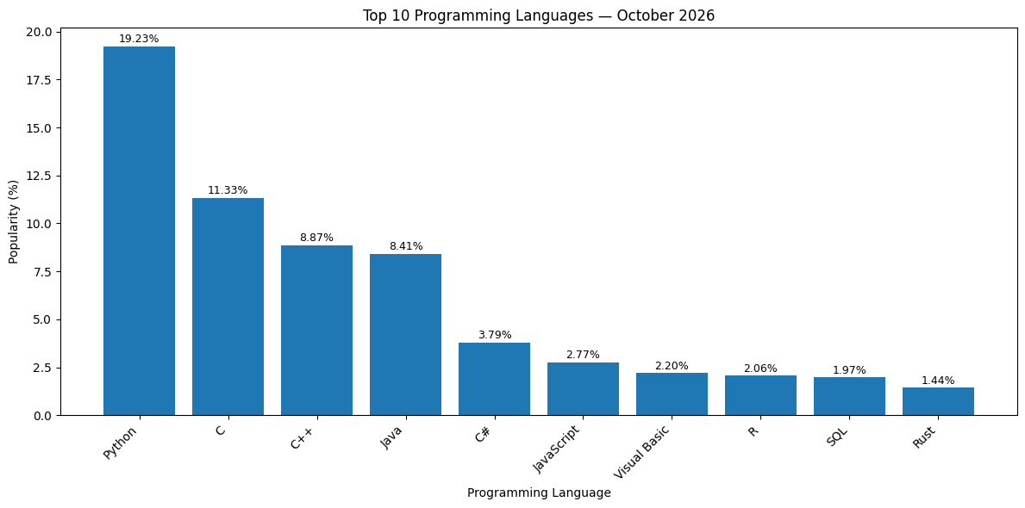
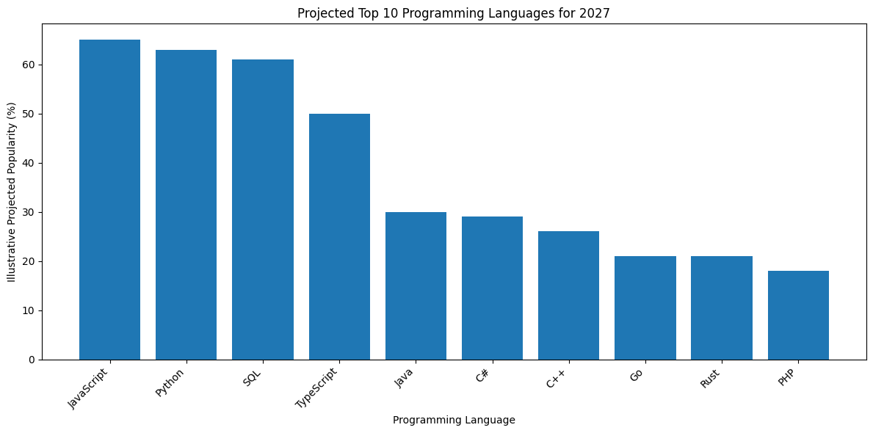
PROGRAMMING LANGUAGE TRENDS
The chart helps compare average annual salaries across programming languages and identify which languages are associated with higher compensation. These figures show an association, not proof that learning a particular language guarantees a higher salary.
Current Year
Next Year
Python adoption rose by 7 percentage points from 2024 to 2025. JavaScript, HTML/CSS and SQL remain widely used.
Rust leads admiration (72%), followed by Gleam (70%), Elixir (66%) and Zig (64%). Admiration is not the same as usage or future intent.
Source: Stack Overflow Developer Survey 2025 (official published aggregate results) | https://survey.stackoverflow.co/2025/

Slide 10
PROGRAMMING LANGUAGE TRENDS - FINDINGS & IMPLICATIONS
Findings
JavaScript and Python are projected to remain among the most popular programming languages in 2027.
SQL and TypeScript are expected to maintain strong demand due to their use in data analysis and modern software development.
Languages such as Go and Rust may continue to gain attention for their performance and efficiency.
Implications
Learning Python and JavaScript can provide a strong foundation for software development and technology careers.
Developing SQL skills can improve opportunities in data analytics and database management.
Programmers should focus on both language proficiency and practical project experience to remain competitive in the job market.

Slide 11
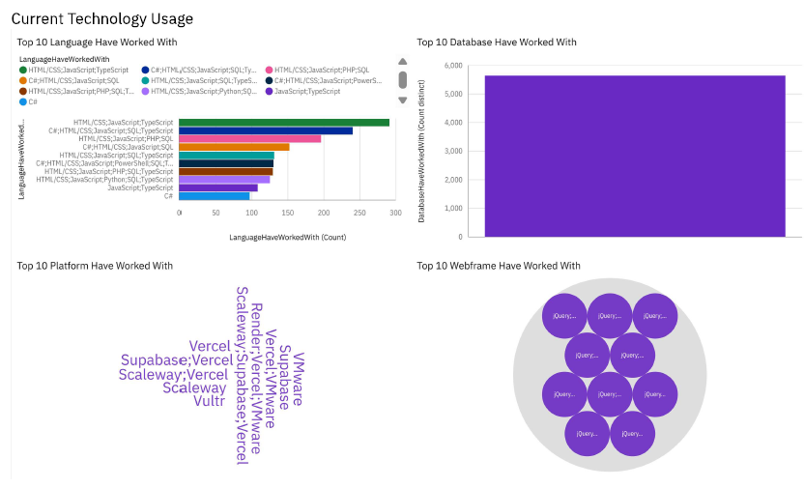
DASHBOARD TAB 1: Current Technology Usage
Source: Stack Overflow Developer Survey 2025 (official published aggregate results) | https://survey.stackoverflow.co/2025/

Slide 12
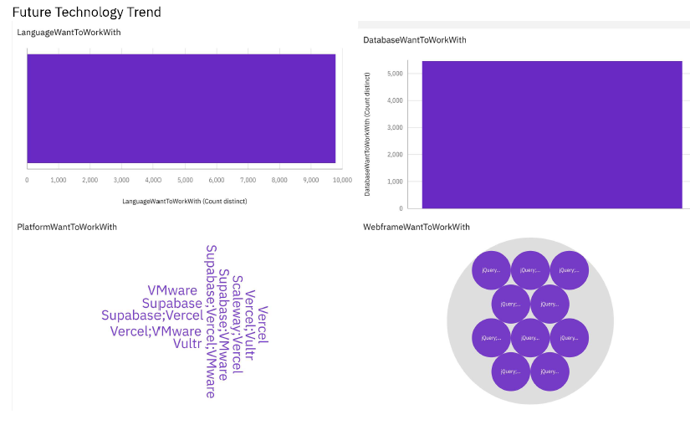
DASHBOARD TAB 2: Future Technology Trends

Slide 13
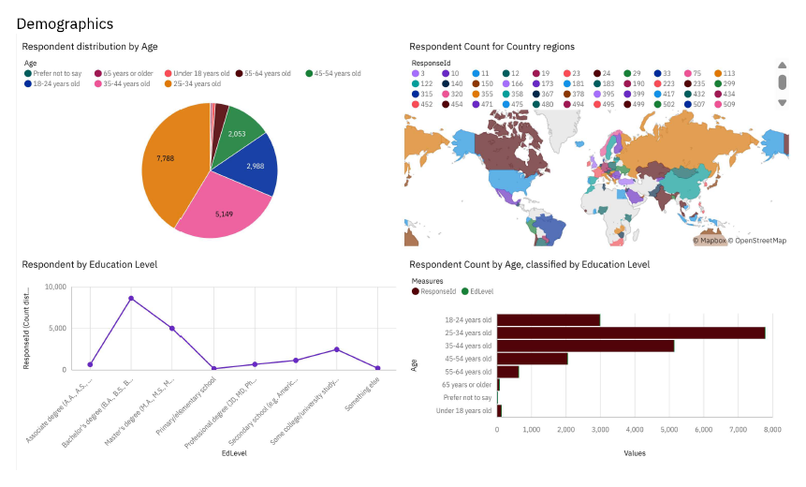
DASHBOARD TAB 3: Demographics

Slide 14

DISCUSSION: WHAT THE ANALYSIS CAN AND CANNOT TELL US
• Distribution charts reveal skew and outliers; compensation is often better summarized by the median than the mean.
• Scatter plots can show associations between age, experience, compensation and satisfaction, but do not prove causation.
• Stacked bars help compare employment and technology preferences, provided multi-select responses are counted consistently.
• Missing values, self-reported compensation, and broad age categories can affect results.
• The official 2025 survey also shows a trust gap in AI: 46% distrust output accuracy while 33% trust it.
• To finalize project-specific claims, rerun the notebook on the exact cleaned CSV and replace public context metrics with local computed outputs where appropriate.
DISCUSSION

Slide 15
OVERALL FINDINGS & IMPLICATIONS
OVERALL FINDINGS
1. SQL and widely used languages remain important foundations.
2. Python is growing and aligns with analytics, AI and back-end work.
3. PostgreSQL is a strong signal for database learning; AI adoption is high but trust remains mixed.
PRACTICAL IMPLICATIONS
1. Prioritize SQL, Python, data cleaning and visualization for entry-level analytics roles.
2. Practice explaining median compensation, missing data, outliers and chart limitations.
3. Treat survey insights as directional evidence and validate them against cleaned project data and current job postings.

Slide 16

CONCLUSION
CONCLUSION
• The project demonstrates an end-to-end exploratory data analysis workflow using Python, Pandas, SQLite and Matplotlib.
• Demographic, work, compensation, satisfaction and technology fields can be analyzed with complementary chart types.
• Published 2025 survey results highlight broad use of established technologies, increased Python adoption and high interest in PostgreSQL.
• Next step: rerun the notebook against the original survey CSV, export the exact charts, and validate all project-specific numbers before submission.

Slide 17

APPENDIX
APPENDIX: DATA DICTIONARY & SOURCES
Project fields used in the notebook
• Demographics: Age, Country
• Work: Employment, RemoteWork, MainBranch, WorkExp, YearsCodePro
• Compensation: ConvertedCompYearly, CompTotal
• Satisfaction: JobSat, JobSatPoints_6, JobSatPoints_7
• Technology: LanguageHaveWorkedWith, LanguageWantToWorkWith, LanguageAdmired, DatabaseHaveWorkedWith, DatabaseWantToWorkWith, PlatformAdmired
Published source for context and figures
Stack Overflow Developer Survey 2025
https://survey.stackoverflow.co/2025/
Technology results:
https://survey.stackoverflow.co/2025/technology
Notes
• Public aggregate metrics are cited in this deck; they are not recalculated from the local CSV because that file was not attached to this request.
• Multi-select survey fields are separated by semicolons and should be exploded before frequency counting.
• Interpret all survey findings with awareness of missing data, self-selection and self-reported responses.

